Slide 1

INTERNET
What is Internet?

Slide 2
Objectives
What is Internet
What is Web
Development of Web
What is Protocol
Markup languages
Web servers and Web Clients
Hypertext Transfer Protocol(HTTP) – how it works

Slide 3
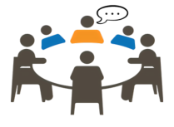
Discussion
What is a Network?
What is the INTERNET?
Is Internet and web the same?

Slide 4
What is a Network?
A network is a collection of Computers, servers, mainframes, Network devices, peripherals, or other devices connected to one another to allow the sharing of data.
The excellent example of network is Internet, which connects millions of people all over the world.

Slide 5
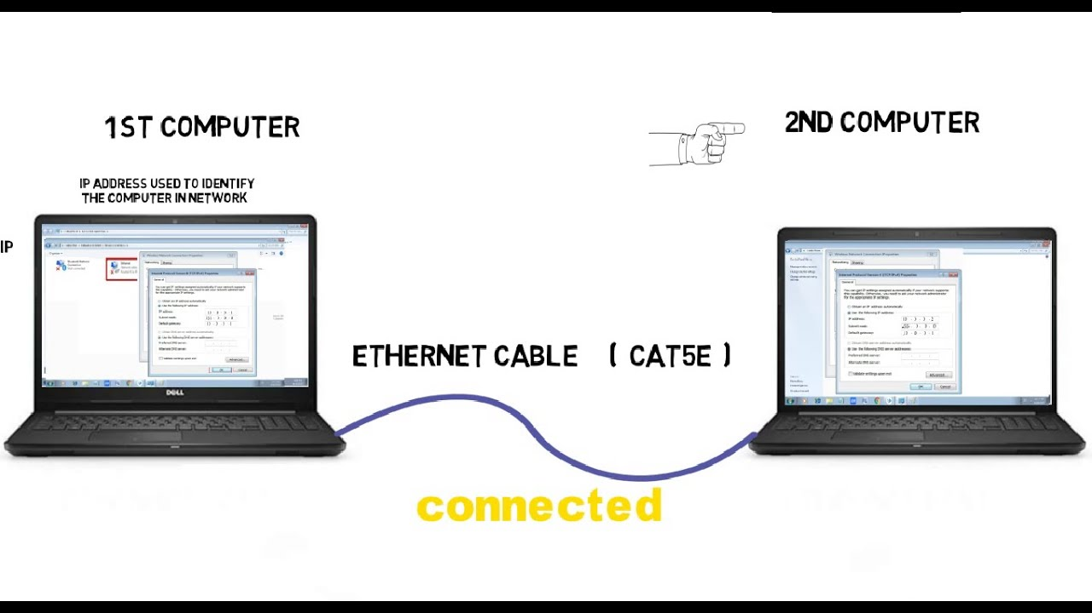
Network

Slide 6
What is INTERNET?
It is the largest network in the world that connects hundreds of thousands of individual networks all over the world.
A means of connecting a computer to any other computer anywhere in the world via dedicated routers and servers.
An internet is a global network of networks.

Slide 7
What is INTERNET?
The internet is made up of independently operated networks which is fully distributed and there is no central control which decides how packets (data) are routed , who connect with whom etc….
Which is all business decisions are made independently by the operators.

Slide 8
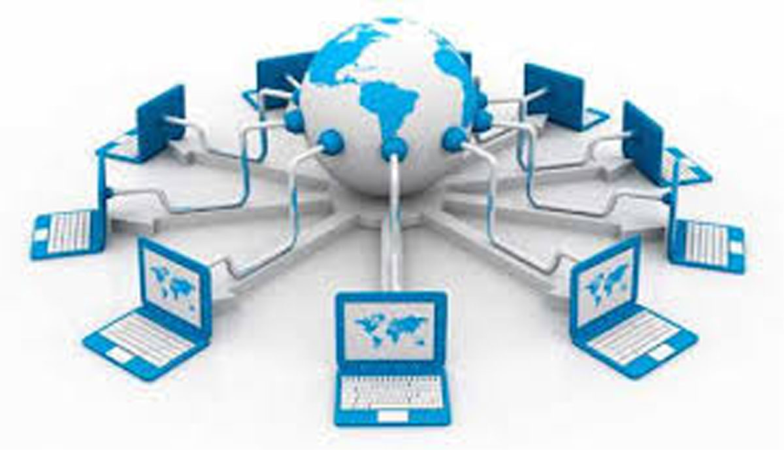
What is INTERNET?

Slide 9
What does the Internet do?
The internet has one very simple job: which is to move computerized information(known as data) from one place to another.
The machine that make up the internet treat all the information they handle in exactly the same way.
In this respect, the internet works s bit like the postal service. letters are simply passed from one place to another ,no matter who they are from or what message they contain .

Slide 10
How to access the internet ?
To access the internet, an existing network need to pay a small registration fee and agree to certain standards based on the TCP/IP(Transmission Control Protocol/Internet Protocol) reference model.
Each organization pays for its own networks and its own telephone bills, but those cost usually exist independent of the internet.
Another way to access the internet is through internet service provider(ISP).

Slide 11
Internet service provider(ISP)
The term “internet service provider(ISP)” refers to a company that provides access to the internet to both personal and business customers.
A commercial organization with permanent connection to the internet that sells temporary connections to subscribers.
Examples : ETC, Prodigy, America Online, Microsoft network, AT & T Networks.

Slide 12
THE WEB(World Wide Web)
The Web(World Wide Web) consists of information organized in to Web pages containing text and graphic images.
It contains hypertext links, or highlighted keywords and images that lead to related information.
A collection of linked web pages that has a common theme or focus is called a Web site.
The main page that all of the pages on a particular Web site are organized around and link back to is called the site’s home page .

Slide 13
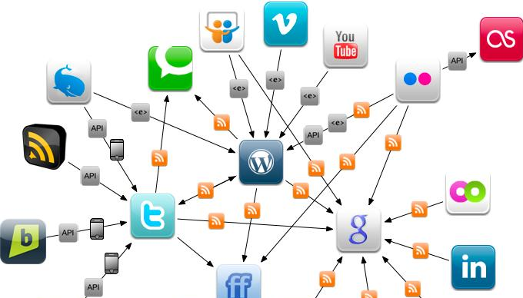
THE WEB(World Wide Web)

Slide 14
How to access the Web?
Once you have your internet connection , then you need special software called a Browser to access the web.
Web browser are used to connect you to remote computers, open and transfer files, display text and images.
Web browser are specialized programs.
Examples of web browser: Netscape Navigator(Navigator) and internet explorer.

Slide 15
Client/Server Structure of the Web
A collection of files that reside on computers called Web servers. That are located all over the world and are connected each other through the Internet.
when you use your Internet connection to become part of the web , so your computer becomes a Web Client in a world wide client/server network.
A Web browser is the software that you run on your computer to make it works as a web client.

Slide 16
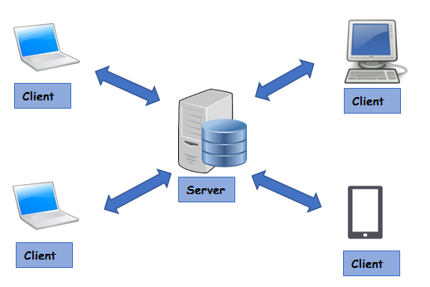
Client/Server Structure of the Web

Slide 17
ADDRESSES ON THE WEB
QUESTION
How can the computers send the data each other through the Internet?

Slide 18
Addresses on the Web:- IP Addressing
Each computer on the internet does have a unique identification number , called an IP(Internet protocol) address.
The IP addressing system currently in use on the Internet uses a four-part number.
Each part of the address is a number ranging from 0 to 255, and each part is separated from the previous part by period. Example: 106.29.242.17

Slide 19
Uniform Resource Locators(URL)
The IP address and the domain name each identify a particular computer on the Internet.
However, they do not indicate where a Web page’s HTML document resides on that computer.
So to identify a Web pages exact location, Web browsers rely on Uniform Resource Locator(URL)

Slide 20
Uniform Resource Locators(URL)
URL has the following syntax:-
Protocol://hostname:port/path-and-file-name
There are four part in the URL
Protocol:- The application level protocol used by the client and server eg:-HTTP, FTP and TELNET

Slide 21
Uniform Resource Locators(URL)
2. Hostname:- the DNS name eg(www.yahoo.com) or IP address(192.165.10.120) of the server.
3.Port:- the TCP port number that the server is listening for incoming request from the clients.
4.Path-and-file-name:- the name and location of the requested resource under the server document base directory .
Eg: http://www.yaho.com/webdevanddesign/index.html

Slide 22
Domain Name System(DNS)
A DNS or a domain name system is used to translate domain names into IP addresses, allowing the browsers to access other internet resources.
When users enter a domain name into the address bar of their web browser, they will be taken to the site they want to visit. However, this seemingly instant task consists of several steps known as the DNS lookup or DNS resolution process.
NO other computer on the Internet has the same domain name.

Slide 23
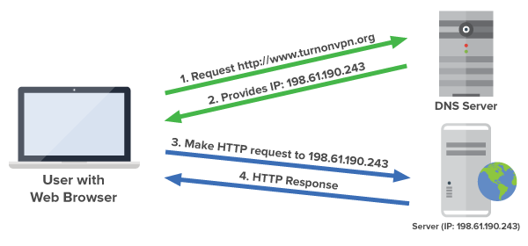
Domain Name Addressing (how it works ?)

Slide 24
HTTP CONCEPTS
Http is a protocol for transferring files( text, graphics, ….)on the www.
The rule governing the conversation between a Web client and a Web server.
but what is protocol? And what does it mean?

Slide 25
What is a Protocol?
In diplomatic circle , a protocol is the set of rules governing a conversation between people.
But we have seen that the client and server carry on a machine-to-machine conversation so they need a rule for that .
A network protocol is the set of rules governing a conversation between a client and a server.
There are many protocols eg: TCP/IP, FTP, HTTP, SMTP etc..
So HTTP is one of those protocols

Slide 26
How HTTP Works?
HTTP is implemented in two programs: a client program and a server program, executing in different end systems, talk to each other by exchanging HTTP messages.
The HTTP client first initiates a TCP connection with the server.one the connection is established, the browser and the server processes access TCP through their socket interfaces.

Slide 27
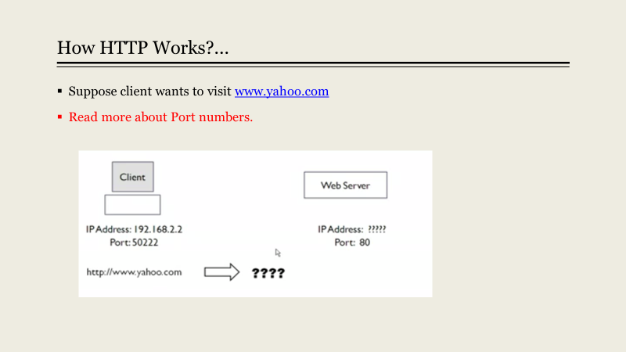

Slide 28
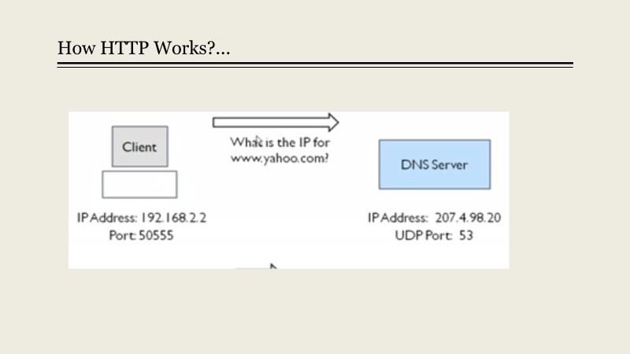

Slide 29
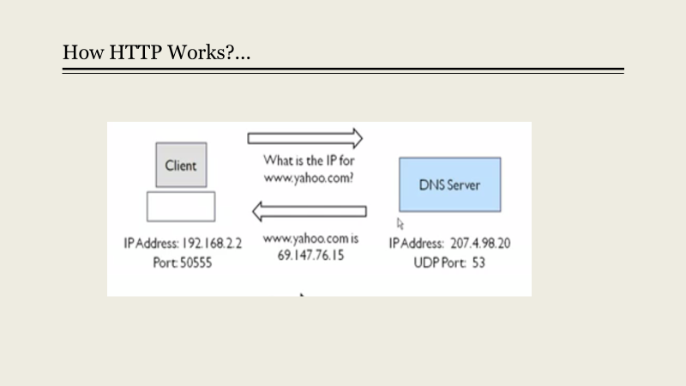

Slide 30
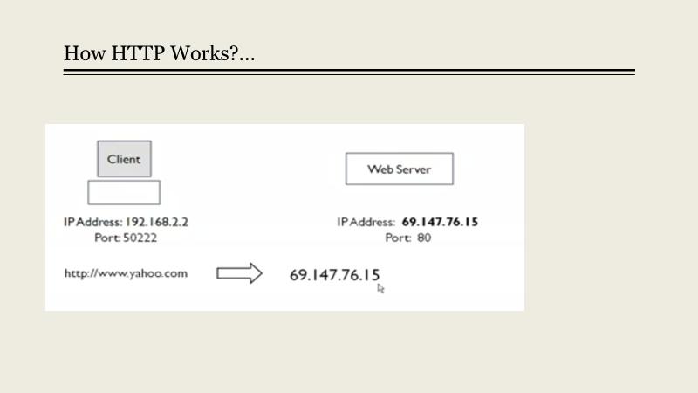

Slide 31
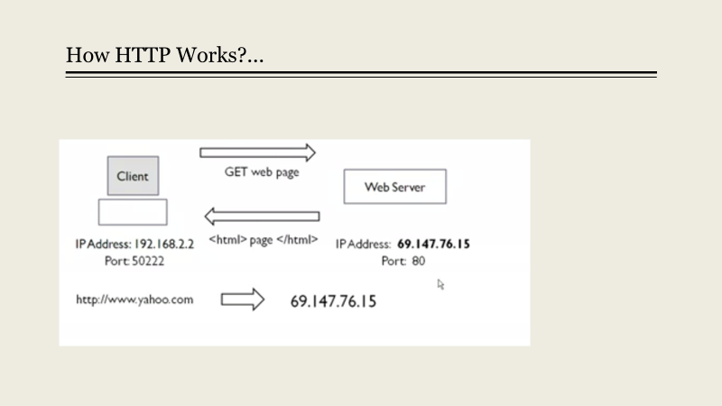

Slide 32


